Slide 2
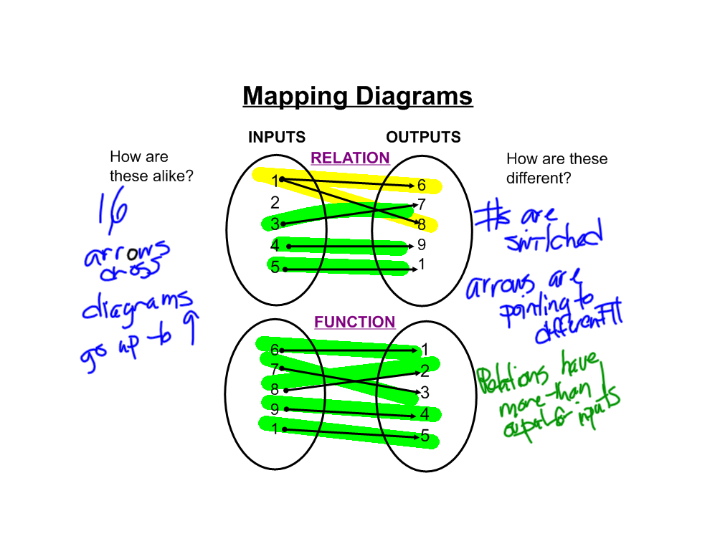

Slide 4
Day | Mon | Tues | Wed | Thurs | Fri
Number of Students | 14 | 12 | 18 | 7 | 2

