Slide 4
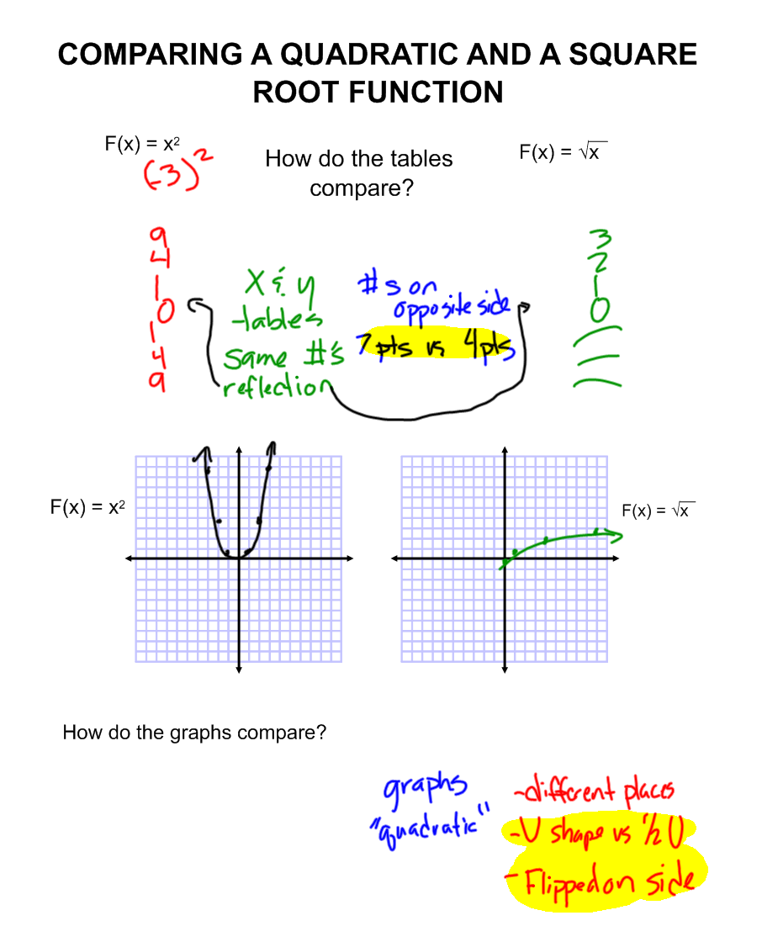
SAME
DIFFERENT
SAME
DIFFERENT

Slide 5
